Slide 1
INDIAN INSTITUTE OF INFORMATION TECHNOLOGY, ALLAHABAD, U.P, INDIA
Project No: 19
OOM mini project: The Hangman
Professor. Dr. O.P. Vyas & Ranjana Vyas

Slide 2
Developers
ISM2014001 – Biki Chaudhary
IHM20140501 – Rajat Kumar Sahu
BIM2014010 - SanghPriya

Slide 3
Introduction
The Hangman Game is the guessing game i.e. the funny way of learning vocabulary. In this Project, Our code will generate a word which has to be guessed by the player. So, at the output screen there will exist some marked out blanks (short lines) for each letter of a word. Then the player will guess a letter. If that letter is in the word then the project will write the letter at everyplace it appears. If the letter isn't in the word then we cross out the lifelines (which are usually a finite no. of chances) from the list. The player will continue guessing the letters until he can either solve the word or he will end up losing all the lifelines and he will be declared a LOSER. There will be different background music play
Technology Used: Java, Swing, Applet

Slide 4
UML Diagrams illustrating the design of Hangman program
Use Case Diagram
Class Diagram
CRC Diagram

Slide 5
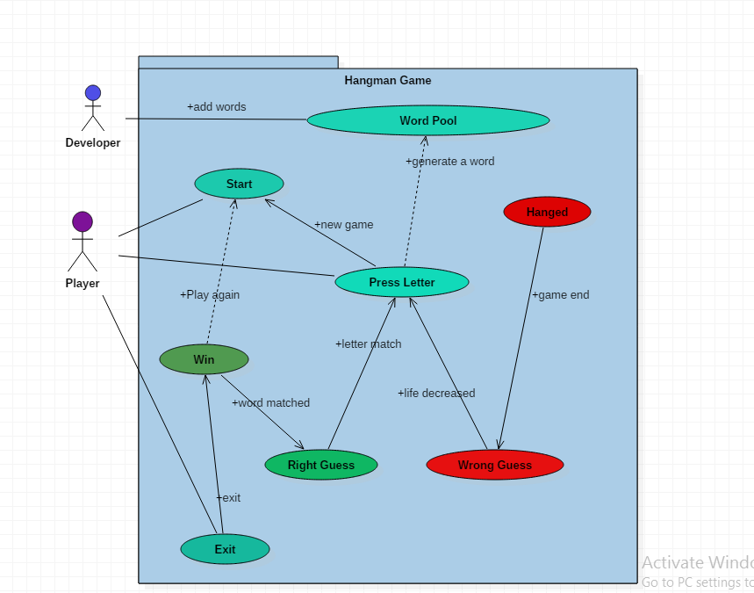
Use Case Diagram: Ultimate Hangman Game

Slide 6
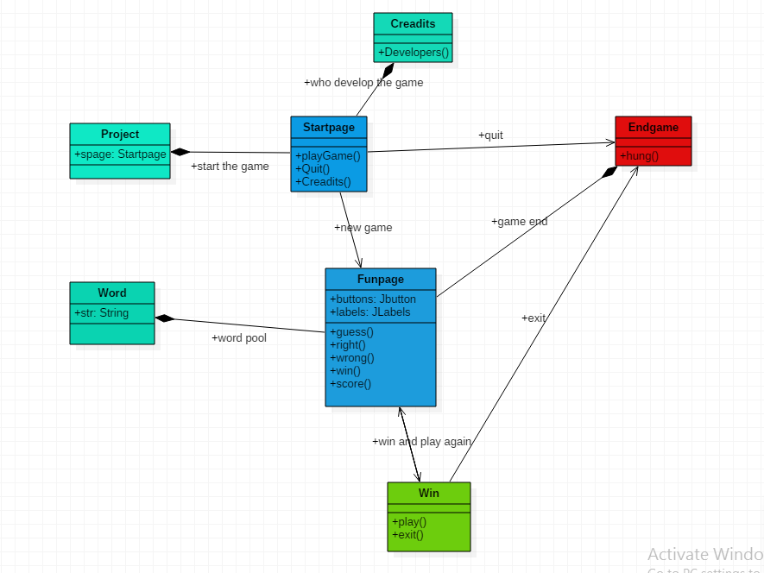
Class Diagram: Ultimate Hangman Game

Slide 7
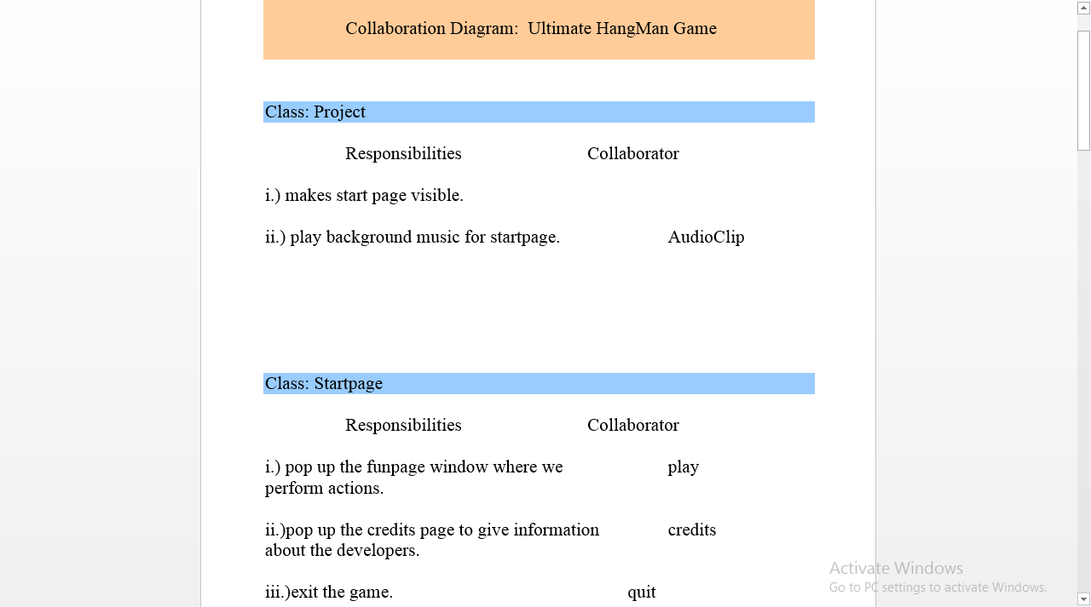

Slide 8
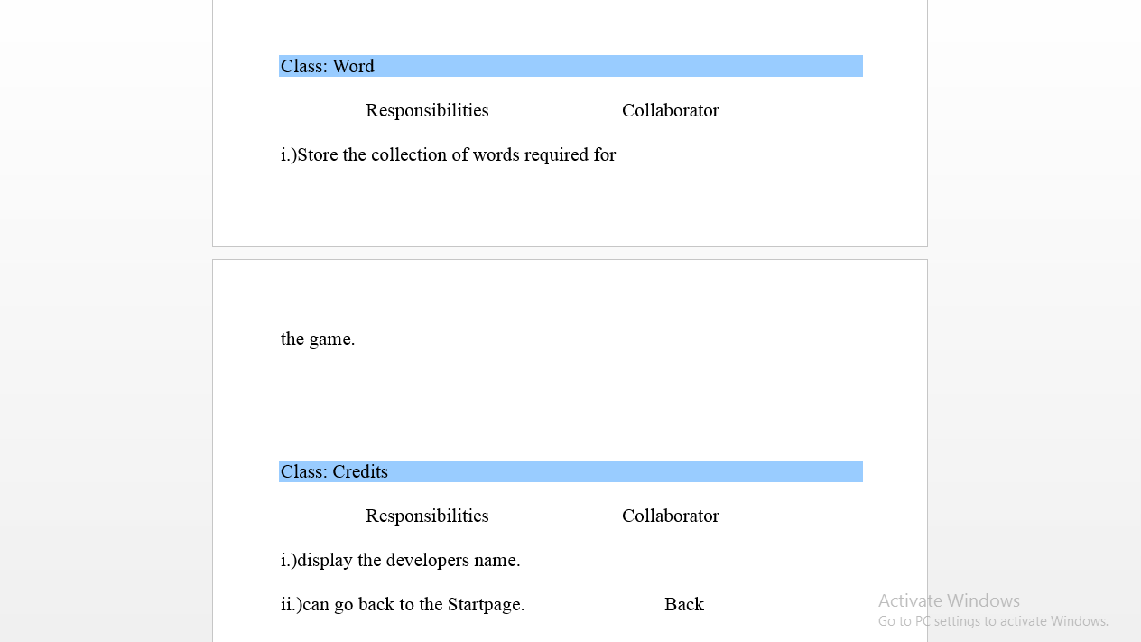

Slide 9
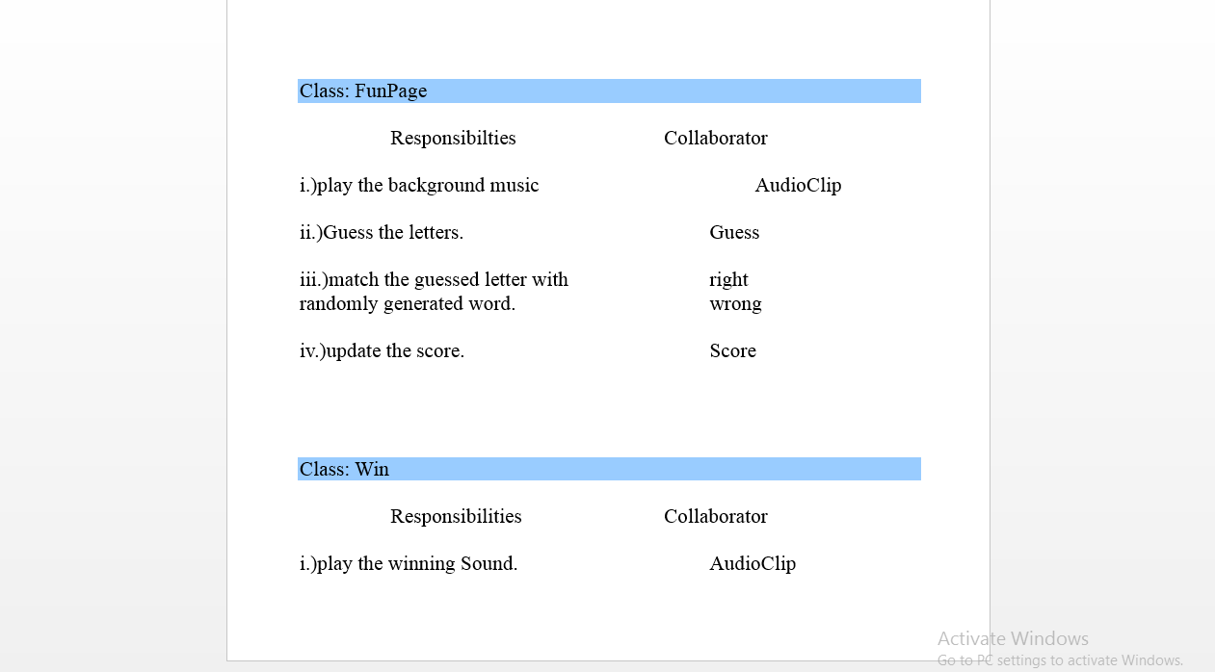

Slide 10
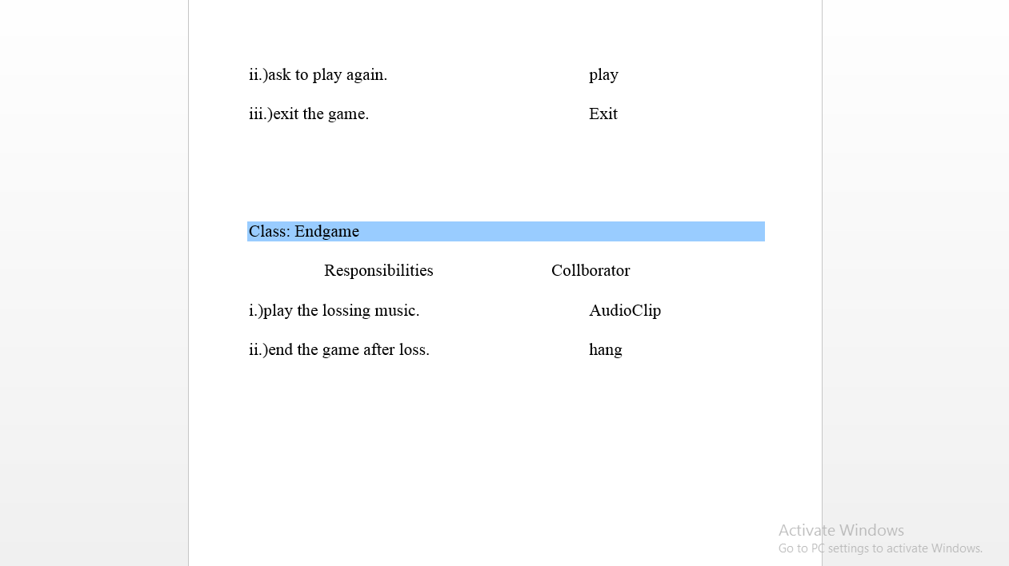

Slide 11
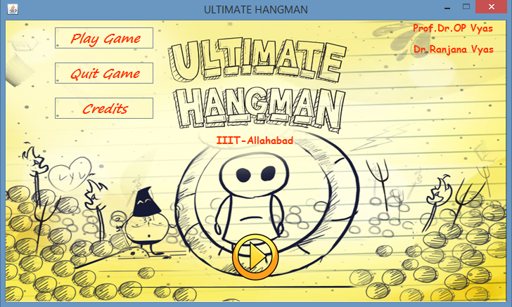
How our Ultimate Hangman Works:
Start page:
When we run our project, the first page displayed will be like given below. It consists of three Jbuttons as shown.
Pop up page where we play ultimate hangman game
directly quit the game
Pop up the developers page

Slide 12
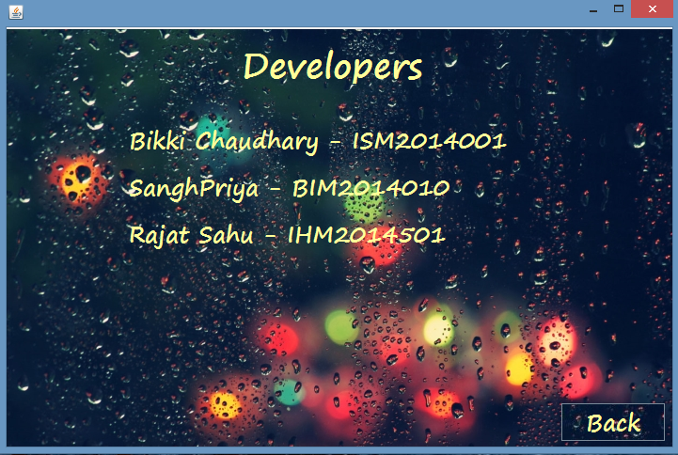
2. Developers Page:
Shows the name of the developers of the Ultimate Hangman Game.

Slide 13
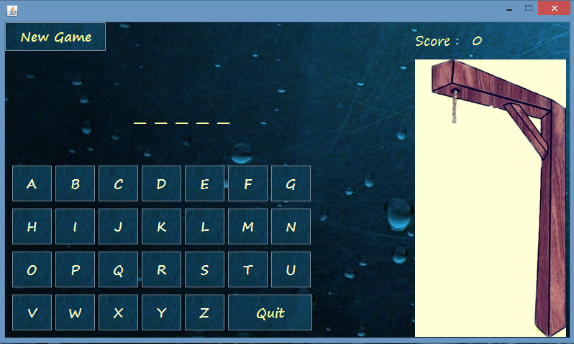
3. Game Page [Fun Page]:
After clicking on “Play Game” Button on start page, the below shown page is displayed where fun begins. “New Game”
button on page is used to restart or reset our game.
To reset or restart the game
Letters guessed are placed in their respected places
Score are updated here
Process of hanging happens
here which indicates life left in the game

Slide 14
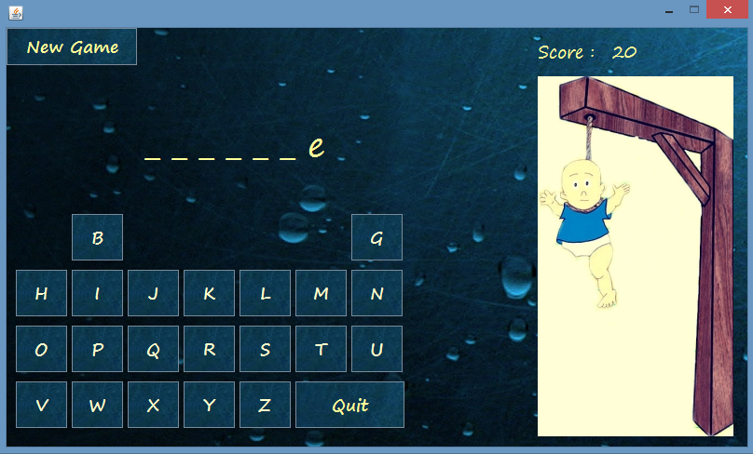
This shows how our game works. Scores are updated and letters guessed are placed in their respected places. Life left are shown by the hanging baby as shown below. In this game buttons are set invisible if pressed once. If that letter is in your word then letter is placed, else life is deducted by process of hanging the baby.

Slide 15
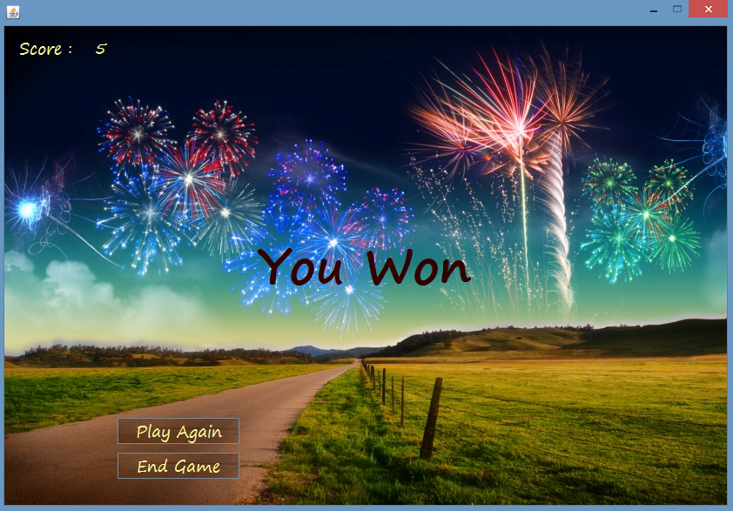
4. Won Page:
This “You Won” page is displayed if you have guessed your word correctly and score is updated. It has got two options:
i.)Play Again
ii.) End Game
Take you to the fun page where new
word is to be guessed now
Ends the game

Slide 16
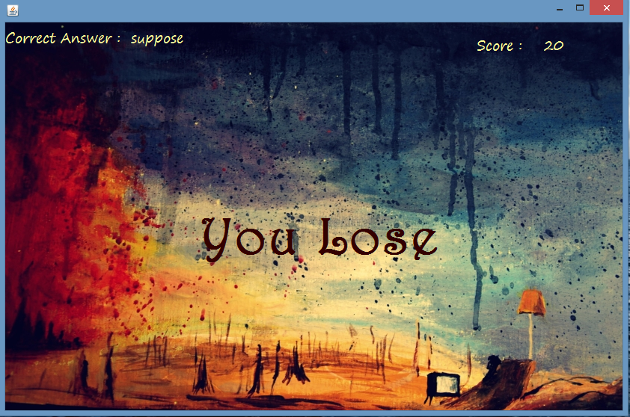
5. Lost Page:
This page shows you the correct answer and your final score is displayed. Declare you as loser and quit the game here.
Final score is declared and our game ends here.
Correct answer is displayed

Slide 17
Conclusion:
Our mini project is finally prepared doing a lots of hard work. We got a chance to learn a lot of things. Seriously, a lot. Our “Ultimate Hangman Game” is working properly and it is really a very interesting game.

Slide 18
Thank You

